Slide 1


Schedule & Booking Tool
Leipzig Tennis School
Pipeline Academy UG | Lisa-Marie Krause | 28.06.2021

Slide 2
Table of Content

Slide 3


Situation & Objective
Situation
Young LTS scaling up fast
Increasing administrational work for coaches
Manual invoices
No SPOT for schedule & members
Problem
Unpaid extra hours
Error prone
Non-profit organization
Implication
Misunderstandings
Erroneous invoices
Double work
Decreasing customer satisfaction
Lost overview
Need
No/low-cost application to simultaneously manage members, schedules, cancellations and invoices
Business analysis
Notes:
Situation:
Head of tennis coaches needs to:
Schedule group/single lessons
Arrange schedule for all coaches
Manage ad-hoc queries
Note cancellations for billing
Problem:
Unpaid extra hours for orchestration & query management
Error prone (need to remember whole day -> no chance to take notes in between classes)

Slide 4







Objective Architecture
Sources | DWH | Kernel | Frontend
Member Administration
Weather API

Slide 5

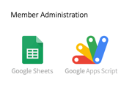
Project Architecture
Sources | Backend (DWH / Kernel) | Frontend
Weather
Forecast
Member
Administration

Slide 6
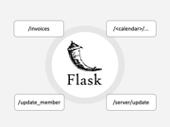

Project Architecture
Sources | Backend (DWH / Kernel) | Frontend
Weather
Forecast

Slide 7



Member Administration

Slide 8
/invoices
/<calendar>/...
/update_member
/server/update

